Slide 1
ICT Solutions - Phishing -
By Hoang Ngan Vu 18156 from WIC.

Slide 2

Hello! I’m Ngan
Hoang Ngan Vu - 18156.
I’m a student at Wells International College undertaking Diploma of Information Technology.

Slide 3
Table of contents.
01 | Overview
02 | Gantt Chart
03 | Cybersecurity
04 | Data Breach
05 | Project Team
06 | Protection
We will talk about this first.
We will talk about this second.
Then, we will talk about this.
After that we will talk about this.
We will also talk about this.
And we will talk about this last.

Slide 4
What is Phishing?
Phishing is a type of social engineering attack often used to steal user data, including login credentials and credit card numbers. It occurs when an attacker, masquerading as a trusted entity, dupes a victim into opening an email, instant message, or text message.
The recipient is then tricked into clicking a malicious link, which can lead to the installation of malware, the freezing of the system as part of a ransomware attack or the revealing of sensitive information.

Slide 5
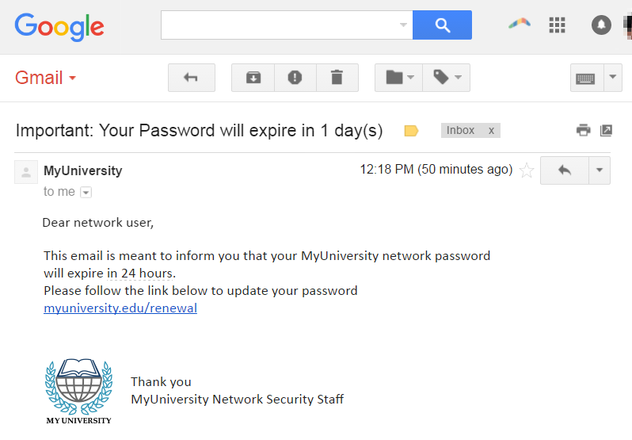
Phishing Attack Example

Slide 6
Phishing Techniques and How to Prevent?
Email phishing scams: attack by sending thousands of fraudulent messages.
Spear phishing: targets a specific person or enterprise.
Solutions:
Two-factor authentication (2FA).
Enforce strict password management policies.
Educational campaigns

Slide 7
We will talk about this first.
01
IT SOLUTIONS USE CASE: Cyberthreats are everywhere. External. Internal. When it comes to security and compliance, we've got your back.

Slide 8
Did you know?
We focus on the technology professional first and foremost.
We address a gap in the security market by helping you to maintain a more secure operational environment.
We provide the IT security software tools that help you make faster and better security decisions with fewer resources. We call it Security Simplified.

Slide 9
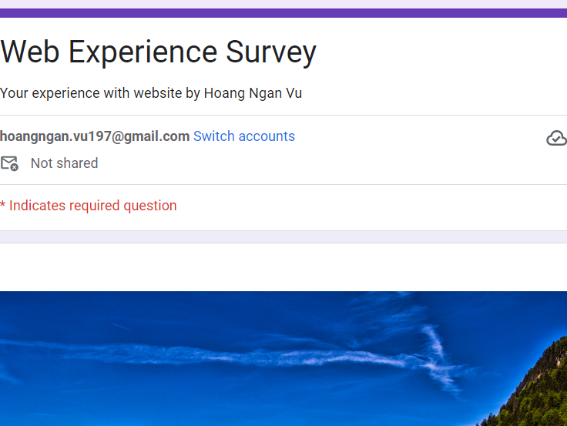
My survey.
Visit and fill out the survey here.

Slide 10
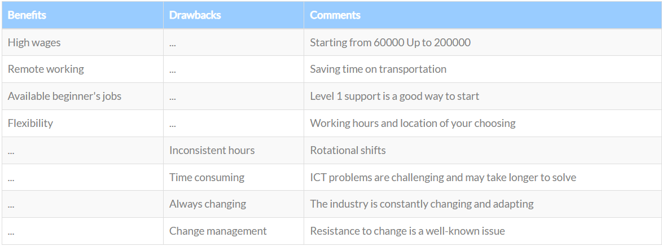
Pre-ICT Knowledge

Slide 11
We will talk about this second.
02
Gantt Chart – Solution Implementation Timeline.

Slide 12
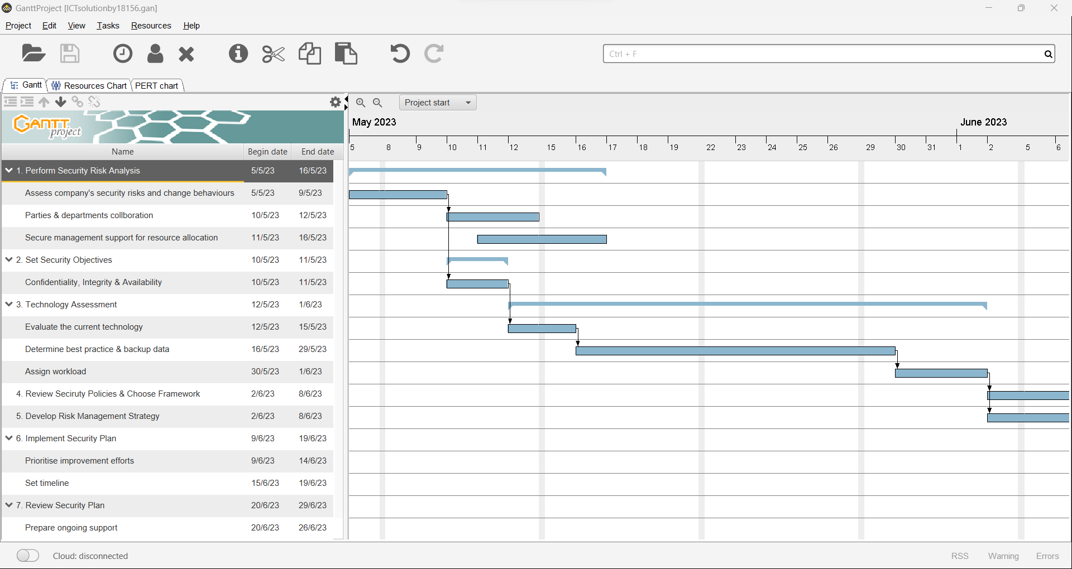
System Timeline

Slide 13
Then, we will talk about this.
03
Cyber security is the application of technologies, processes, and controls to protect systems, networks, programs, devices and data from cyber attacks.

Slide 14

Cybersecurity is important.
The costs of cyber security breaches are rising.
Cyber attacks are increasingly sophisticated.
Cyber security is a critical, board-level issue.
Cyber crime is a big business.

Slide 15
After that, we will talk about this.
04
A data breach is an incident where information is stolen or taken from a system without the knowledge or authorization of the system's owner.

Slide 16
Did you know?
Most data breaches are attributed to hacking or malware attacks.
A data breach consists of Research, Attack and Exfiltrate.
Data breach legislation differs in every country or region. Many countries still do not require organizations to notify authorities in cases of a data breach.
Organizations are obliged to notify affected individuals of a data breach under certain conditions.

Slide 17
We will also talk about this.
05
The project team will be responsible for translating the company's vision into an executed design, maximizing the outcome and minimizing risk.

Slide 18


This is our team.
Brie - Supervisor
Mikaela – Manager
Jamie - Assistant
Ensure roles are well-defined and the atmosphere is positive.
Demonstrate leadership and clear goals.
Ensure open communication and trust.

Slide 19
And we will talk about this last.
06
Password security and password protection are practices for establishing and verifying identity and restricting access to devices, files, and accounts.

Slide 20
Password protection helps ensure that only those who can provide a correct password in response to a prompt are given access.
― Research

Slide 21
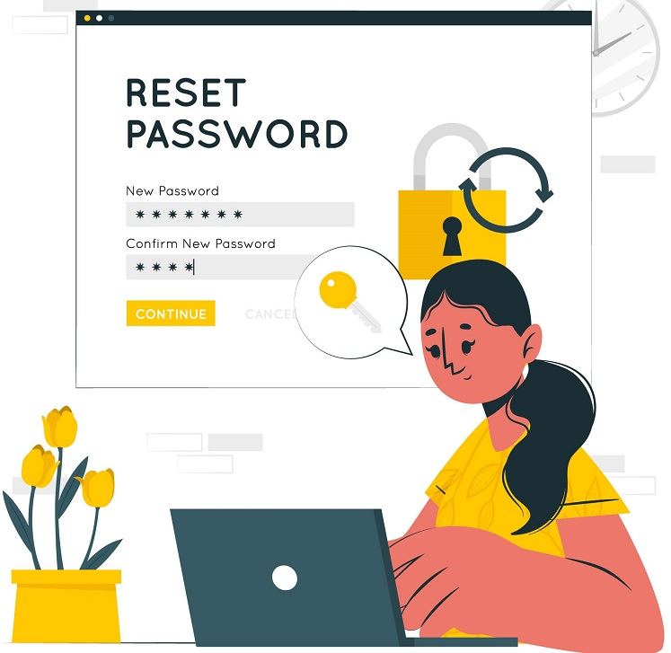
Useful methods.
Embed security in training and culture.
Change passwords frequently.
Safely store passwords as credentials

Slide 22
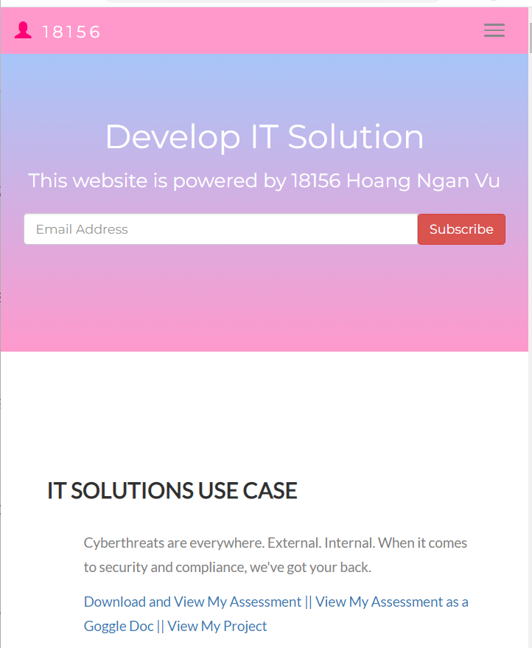
Interested in accessing my website from your tablet?
Here’s a look at it!

Slide 23
Thank you!
Do you have any questions?
hoangngan.vu197@gmail.com
18156@wic.edu.au
Wic.edu.au

